Slide 1
People Mindset About Taxies
TaxiCabs
Rickshaws

Slide 2

Ride On 2 Wheels
We Will not be an option, We will be the Choice…
Guide:
Prof. Roopa Muragi
Presenters:
Prasannakumar C S (19U11651)
Ravichandra Rathod (19U11662)
BCA VI SEM

Slide 3
OVERVIEW
INTRODUCTION
ADMIN MODULE
USER MODULE
SYSTEM ANALYSIS
OUR SERVICES
DISCUSSION OF THE RESULTS
CONCLUSION

Slide 4
INTRODUCTION
Ride On Two Wheels is a startup which provides bike taxi service in some of the Districts in the Karnataka.
We offers unique features where one can ride solo(Rent a Bike), book a quick Ride(Emergency Ride), Book a Ride (with driver).
Ride On Two Wheels is the cheapest, fastest, efficient and most convenient way to commute in these cities always packed with traffic.
bike taxis have increased over the past years in territories of cities in Karnataka
Ride On Two Wheels is the bike taxi service provider, which connects travellers to drivers for short distance drive.
The various modules of this system areas:
Admin Module
User Module

Slide 5
Admin Module
Register User.
Create SuperUser.
Create, Delete, Modify Customer and Customers Details.
Handles The Customer Feedback And Solve The Problems

Slide 6
User Module
New User Registeration
Customer Login
Book A Ride
Emergency Booking
Rent A bike
Register As Rider

Slide 7
System Analysis
Hardware requirements:
Number | Description
1. Hard-Disk | PC with 500 GB
2. RAM | 4 GB
Software requirements:
Number | Description
1.Operating System | Windows, Linux
2.Database | SQLite3
3. Programming Languages | HTML(with CSS),, Python, Django

Slide 8
Data Flow Diagram
Rides On 2 Wheels
Customers
Admin

Slide 9




CRUD Operation By Admin
Add:
Delete:
Admin can add the user details,Service price.
Admin can remove user,
His Bookings
ADMIN
Update:
Display:
Admin can maintain web page by updating the data, price.
Admin can view all details related to user registartions,uploaded queries(Contact Us)

Slide 10





Our Services
Book A Ride
Emergency
Ride
Rent A Bike
Register As a Rider

Slide 11




Payment Using Rezorpay
Scan
UPI
NetBanking
DebitCard

Slide 12
SCREEN-SHOTS

Slide 13
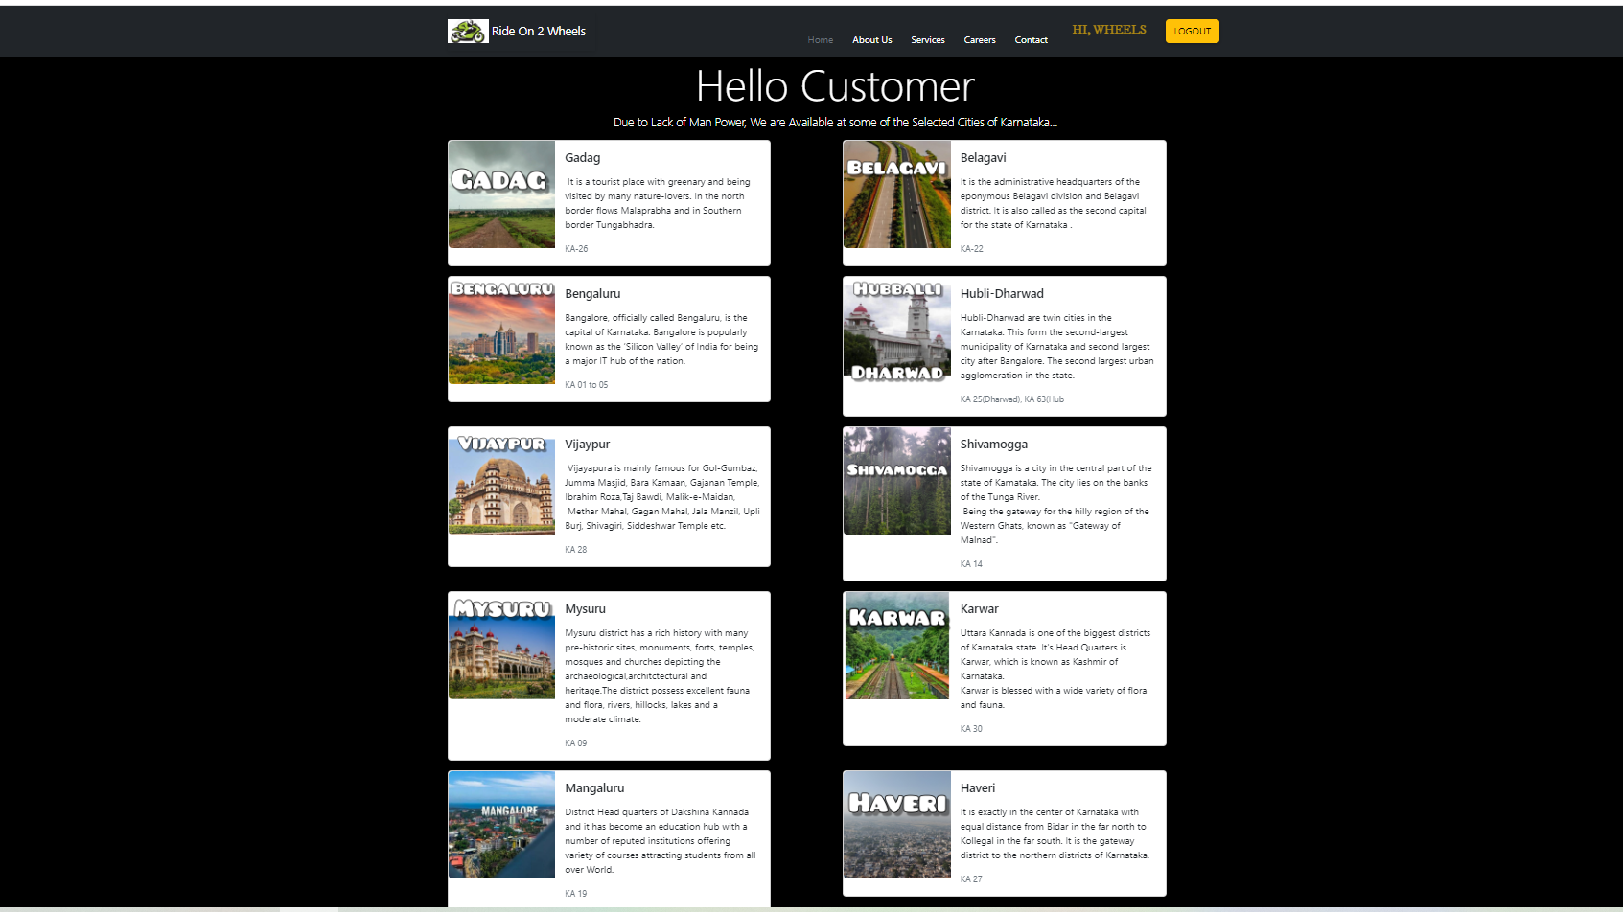
Home-Page

Slide 14
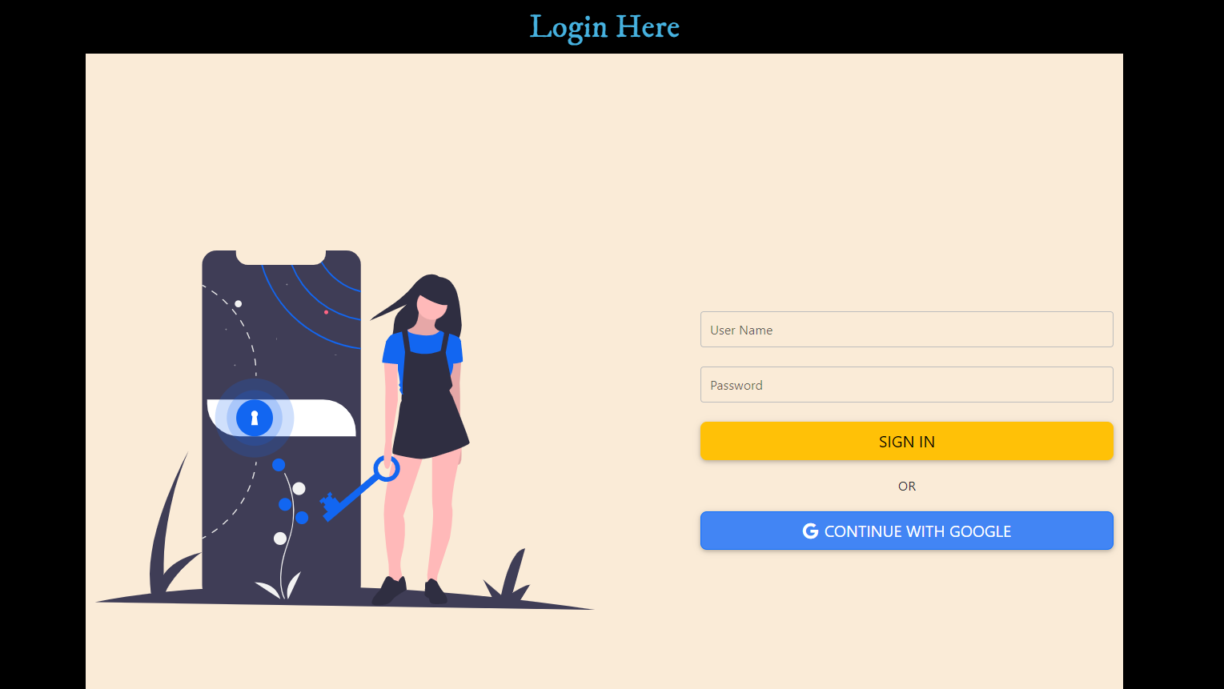
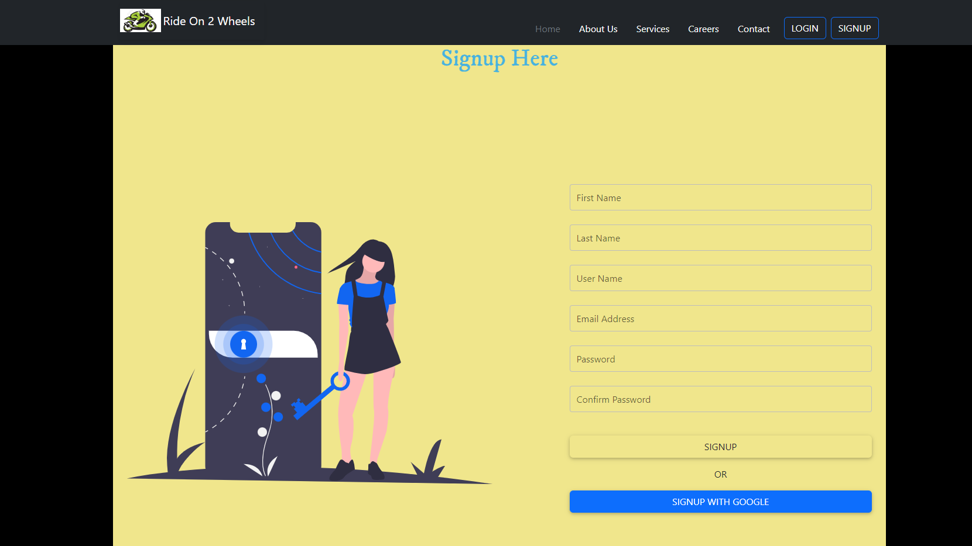
USER LOGIN AND SIGN-UP PAGE

Slide 15
CONCLUSION
Highly Economical Services Compared to other Transportations
Can Bypass Easily in Rush Roads
The Project Developed Using
HTML
BOOTSTRAP
PYTHON
DJANGO

Slide 16
Thank-You

